Slide 1
5-9
Tara, Amy, Platon, Anooshree

Slide 2
5-9
Value Proposition: Intentionality after work.
Problem Statement: For new grads, dedicating purposeful time towards themselves and others can feel impossible—it’s easier to just watch Netflix every day after work. 5-9 solves this problem by making it straightforward to make intentional plans to socialize and engage in self-care, and to reflect on how you spend your time after work. Whether it’s seeing an old friend or meditating after a long day of meetings, we’re here to help you create an intentional and meaningful life outside of the office.

Slide 3
5-9
Solution Overview: Graduating from college means leaving behind a centralized community of like-minded peers who you’ve spent four years growing and living with. Many recent graduates report feeling lonely after leaving their campus for a new city and full-time job, and the majority of our interviewees reported both experiencing loneliness as a primary emotion and struggling with establishing methods and structures for effectively spending their free time. Our solution, 5-9, is a mobile app that helps new grads intentionally plan to socialize and engage in self-care throughout the week. We generate suggested activities based on a new grad’s preferences, and give users the chance to reflect on how different activities made them feel. 5-9 will motivate new grads to practice intentionality, follow through on goals, and reflect on how they spend their time!

Slide 4
Values encoded
Values:
Personal accountability
Personal wellness and lifestyle sustainability
Social exploration
Design features:
Asking users to reflect on how an activity made them feel and using this to inform recommendations.
Giving users a weekly report on how they intentionally spent their time.
Providing recommendations for interesting activities nearby.
Suggesting that users engage in both socialization and individual self-care.
Potential Conflicts:
Providing users with a report of how they spent their time could promote intentionality/reflection, but it could also induce FOMO and anxiety.
Promoting both social exploration and self-care is a balance that is difficult to maintain. We need to avoid unintentionally prioritizing one over the other.
Recommending fun activities could add unneeded social pressure and create FOMO, which damages personal wellness.

Slide 5
Tasks
Task One: You’re in need of some R&R. Plan to spend intentional time alone by choosing a free time slot and recommended self-care activity.
Task Two: You miss your friends. Plan to spend intentional time with a friend by choosing a free time slot, an available friend, and a recommended social activity.
Task Three: You want to reflect on how you spend your time. Review and reflect on how you’ve spent your time by reflecting on past activities and viewing your weekly synthesized report.

Slide 6
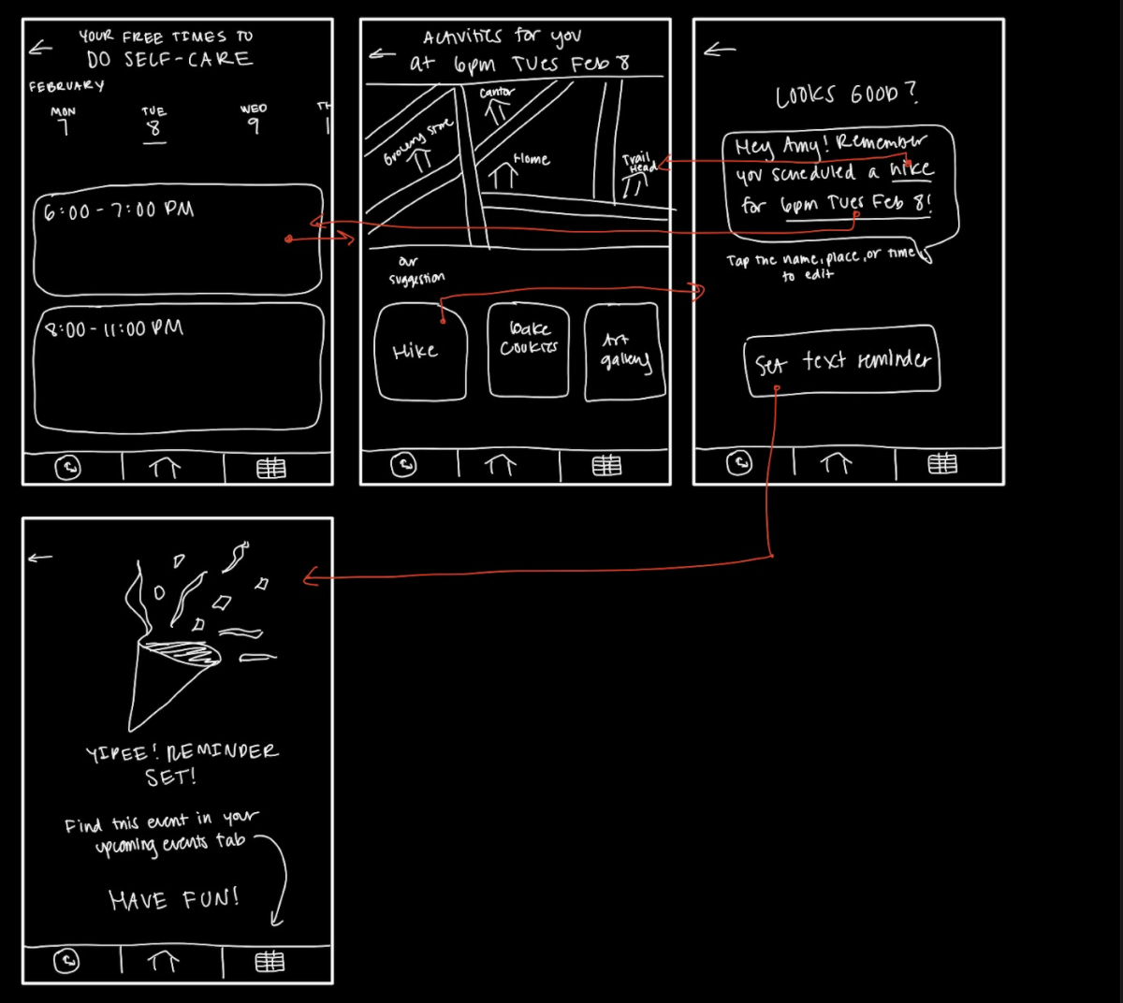
Task One: Plan to spend intentional time alone

Slide 7
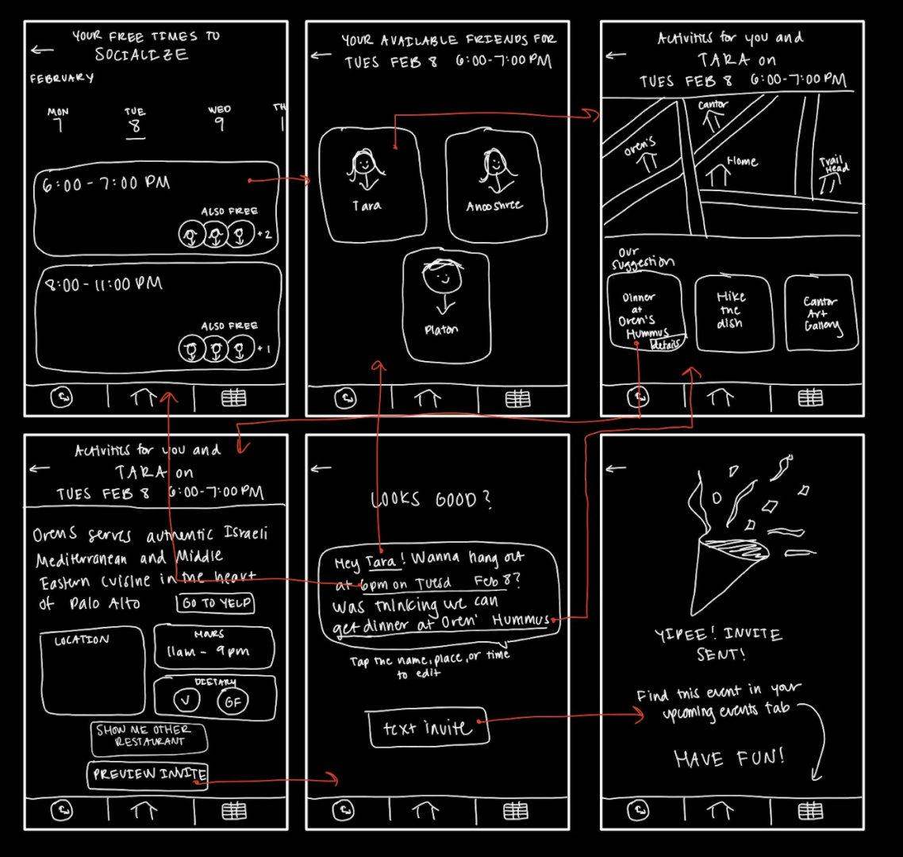
Task Two: Plan to spend intentional time with a friend

Slide 8
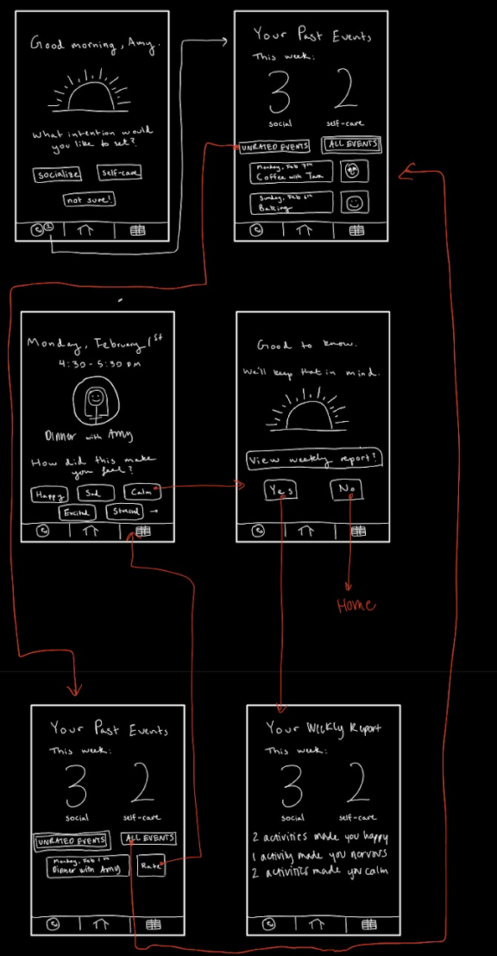
Task Three: Review and reflect on how you spend your time

Slide 9
How our tasks changed
Our original tasks were set intention, do intention, rate intention.
We wanted to fix awkward wording and better represent the full intended functionality of 5-9.
Our simplest task is planning an intentional activity to do alone. Our moderate task is planning an intentional social activity. And our complex task is reflecting on and reviewing how you spend your time (which enables you to figure out how to spend your time most meaningfully).
Notes:
From our feedback last week, we chose to rework our three tasks. They were originally set intention, do intention and rate intention. We changed them to be “plan intentional time alone”, “plan intentional time time with a friend”, and “review and reflect.” We made this decision given the fact that set intention was originally just selecting an option between “socialize, self care, and not sure” instead of being a flow of screens and actions. Furthermore, we received feedback that our “do intention” framing felt awkward. Finally, we wanted to make sure our division between simple/moderate/complex tasks accurately reflected the flow of complexity we foresee for our app.
Our reworked simple task is “plan intentional time alone.” This task involves a user scheduling and selecting a self-care activity for themselves. This is the core and simplest functionality of our app: selecting a free time slot and recommended activity. It only involves the user’s schedule and their choices.
Our reworked moderate task is “plan intentional time with a friend.” This task involves a user scheduling an activity to do with a friend which requires selecting a time slot, a friend, an activity, and then sending an invitation message to the friend. This is a moderate task as it builds on the simple task but adds the complexity of selecting a friend, coordinating with a friend’s schedule, and sending a notification. This is also part of the core functionality we’d hope all users to utilize.
Finally our reworked our complex task is “review and reflect on how you’ve spent your time”. This task involves users going through the process of rating a past activity and viewing their weekly report on past activities. This is a complex task as it requires the user to recognize that there is an unrated activity that they need to rate and then rate that activity. It also involves the user viewing a weekly recap of how their activities so far have made them feel. This connects to our larger goal of promoting intentionality after work: we want users to spend their time meaningfully, and that involves reflecting on how different ways of spending their time made them feel, and how they spent their time overall.

Slide 10
How our tasks changed (detail)
Simple: plan intentional time alone. This task involves a user scheduling and selecting a self-care activity for themselves. This is the simplest functionality: selecting a free time slot and recommended activity.
Moderate: plan intentional time with a friend. This task involves a user scheduling an activity to do with a friend which requires selecting a time slot, a friend, an activity, and then sending an invitation message to the friend. This is a moderate task as it builds on the simple task but adds the complexity of selecting a friend, coordinating with a friend’s schedule, and sending a notification.
Complex: review and reflect on how you’ve spent your time. This task involves a user going through the process of rating a past activity and viewing their weekly report on past activities. This is a complex task as it requires the user to recognize that there is an unrated activity and then rate that activity. It also involves the user viewing a weekly recap. This connects to our larger goal of promoting intentionality after work: we want users to spend their time meaningfully, and that involves reflecting on how different ways of spending their time made them feel.

Slide 11
Usability Goals and Key Measurements
Usability Goals:
Learnable: easier to accomplish setting intention after doing so once
Robust: each task flow is effective in helping users meet socializing/self-care goals
Key Measurements:
We measured the time it took for a user to successfully complete all of our tasks. We took this measurement three times to see if it decreased.
We asked users to rate the app features (setting intention, planning intention, rating intention) out of 5 based on how effective they were to use. We also made a log of critical incidents.
Product Progression:
We designed the self-care and socializing task flows to require similar actions from the user so that completing both requires only one learning curve.
We provided more context and information on potential activities to inform user decisions.
The medium-fi prototype needs to link to users’ calendars, contact lists, and messaging applications to seamlessly integrate into their daily life.
We provided options for users who are unsure about their intentions or how activities are making them feel.

Slide 12
Revised Interface Design

Slide 13
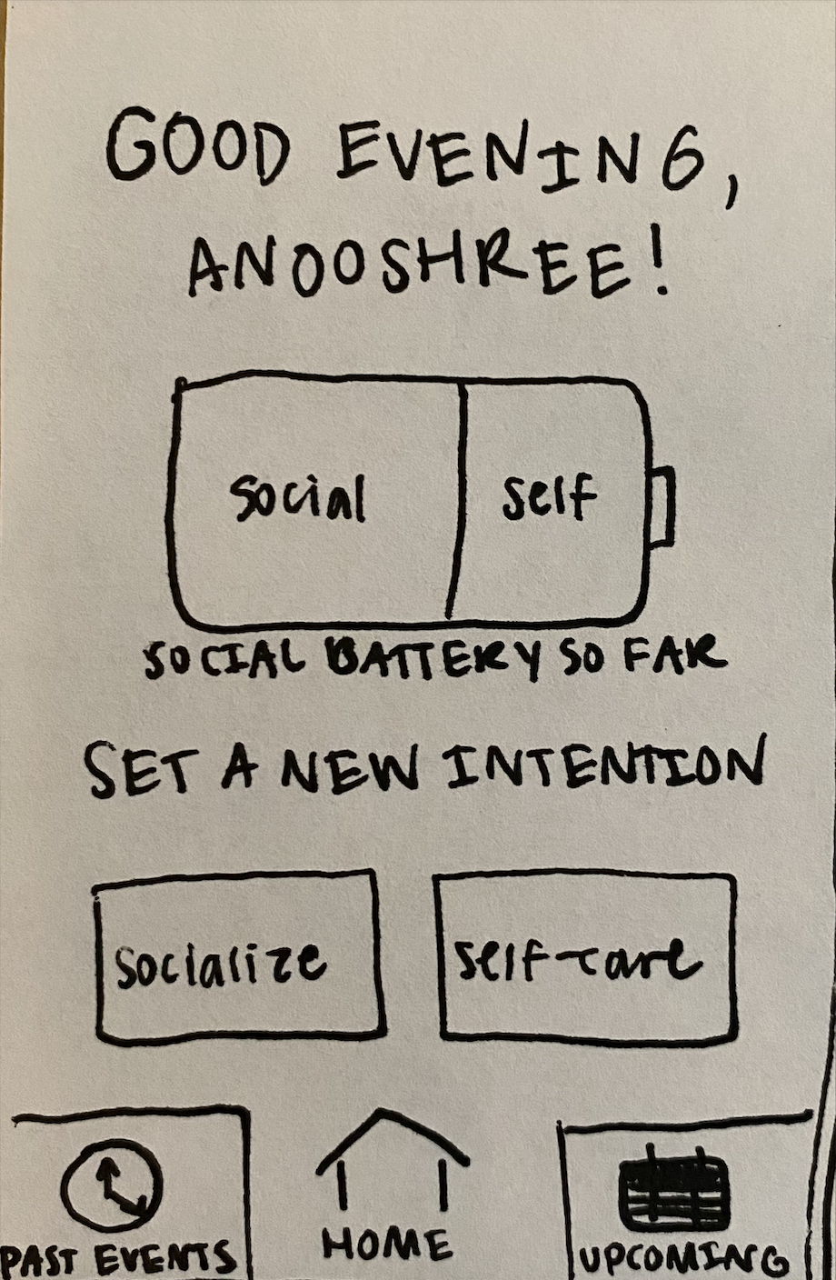
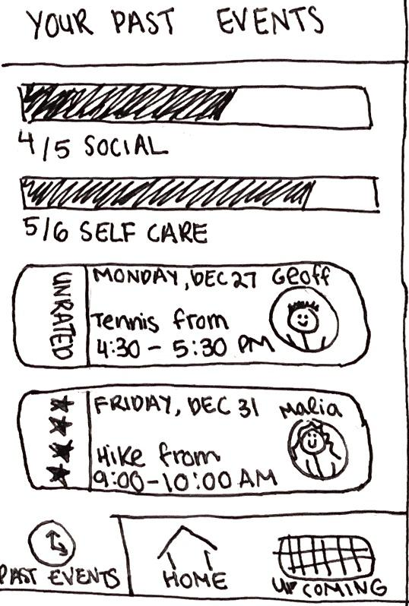
Major Design Change 1 - Social Battery
Before - landing screen & past events overview

Slide 14
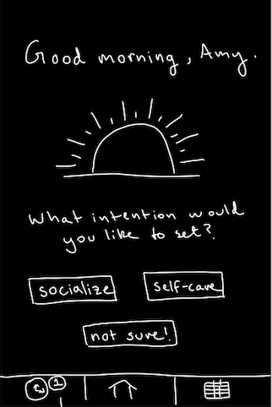
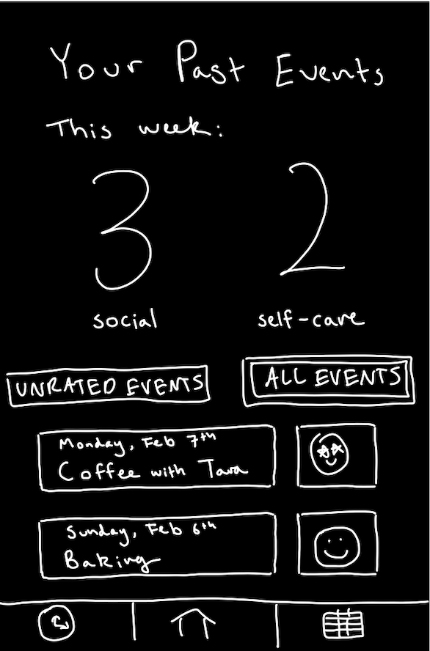
Major Design Change 1 - Social Battery
After - landing screen & past events overview

Slide 15
Major Design Change 1 - Social Battery
Changes
Instead of showing weekly activity tracking as a social battery on the home page, we moved it to the past events tab and changed it to show the number of activities instead of a fraction of scheduled activities
Split up tracking by social/self-care, instead of showing them together
Rationale
All users were confused by the social battery (was it a button?, did it show tracking towards a goal?, does it update or is it static?) and past event tracking bars (what is denominator number?, for the week or all time?)
This way users can focus solely on choosing an intention on the home screen
Tracking of past activities is moved to the more relevant “past events” tab, instead of being on the home screen, users can easily see two large numbers

Slide 16
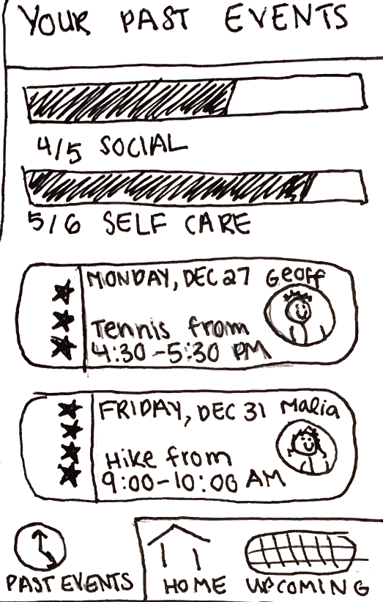
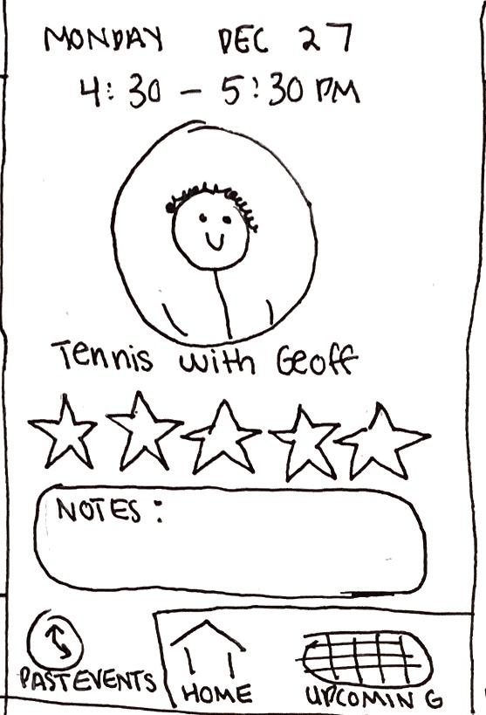
Major Design Change 2 - Rating Scheme
Before - past events & past events with unrated event & rating activity

Slide 17
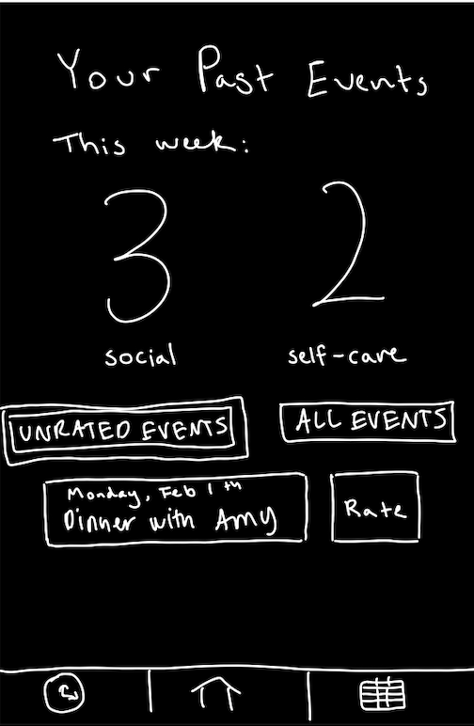
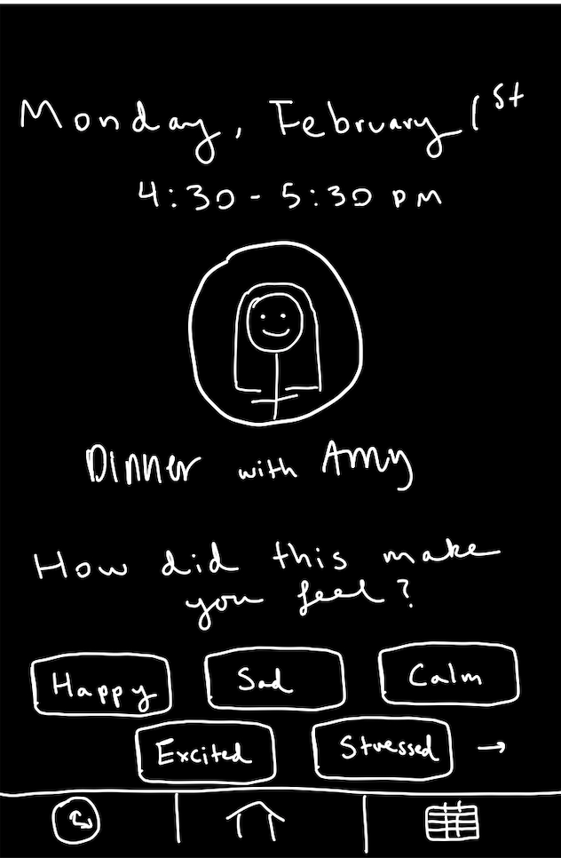
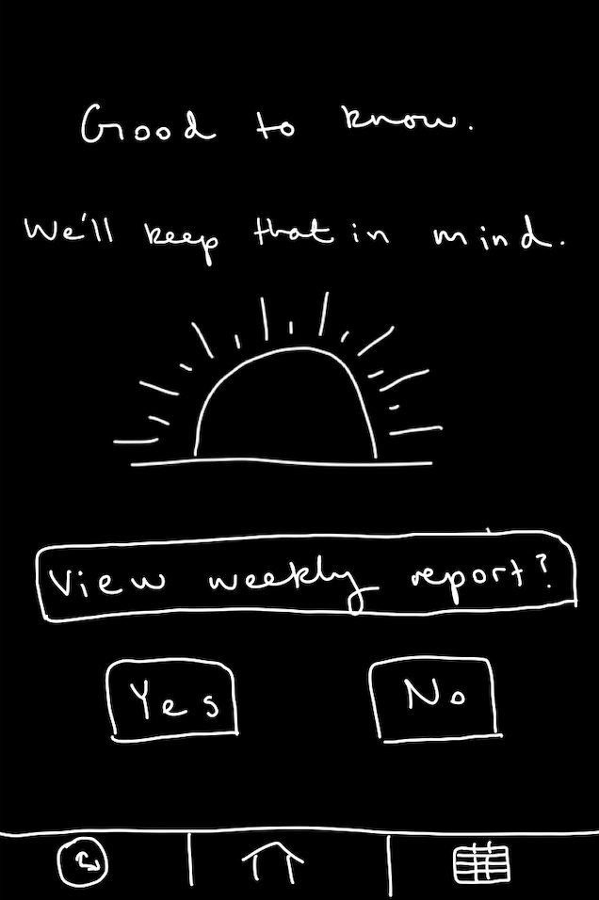
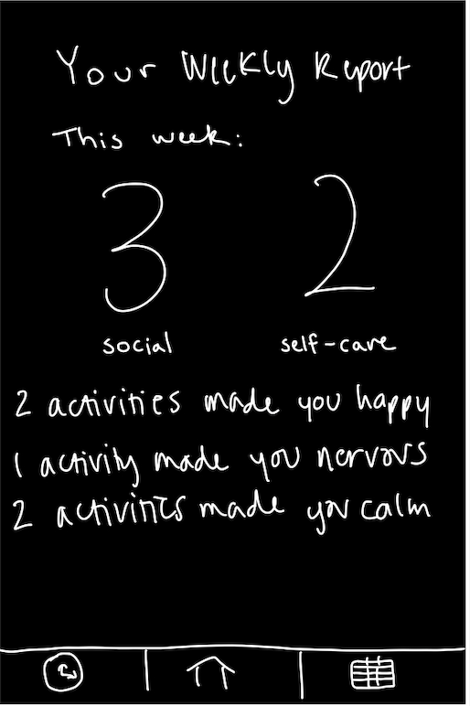
Major Design Change 2 - Rating Scheme
After - unrated event notification, past events unrated filter & rating activity & weekly report

Slide 18
Major Design Change 2 - Rating Scheme
Changes
Emotion based rating system instead of star based system
Toggle between unrated activities and all activities on past events overview
Unrated event notification visible from menu bar
Rationale
User 2 felt that the star rating system was ambiguous, solved through a more relative and clear emotion rating system
Feedback that users may have trouble remembering events during rating process, achieved by unrated event notification on menu bar that prompts rating right after event passes to get them to rate activity ASAP
Better organization of activities by unrated and rated
Give users a way to reflect on how the week’s activities so far have made them feel, this is achieved through the week (so far) report

Slide 19
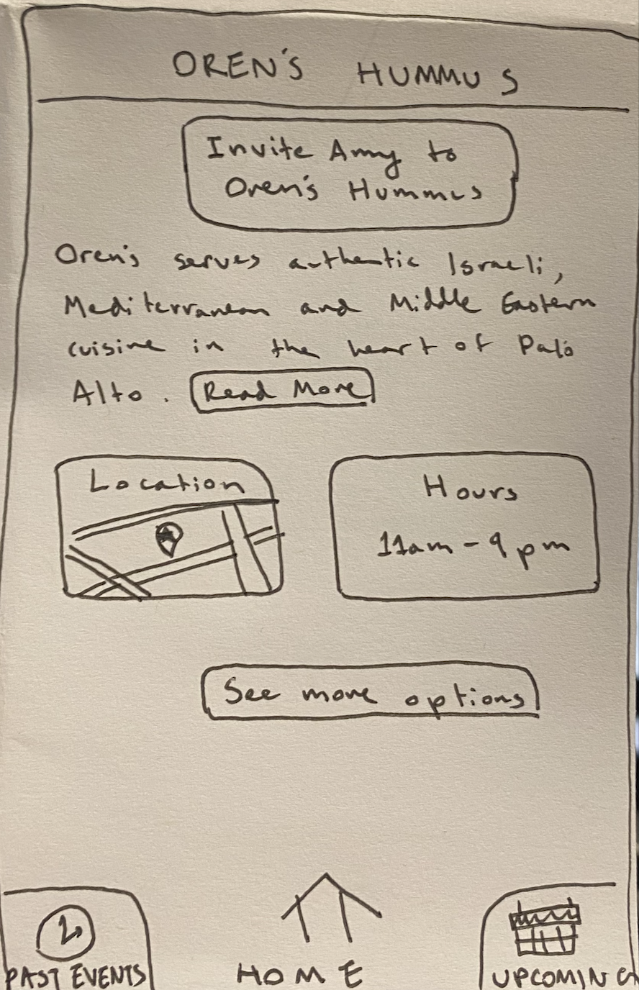
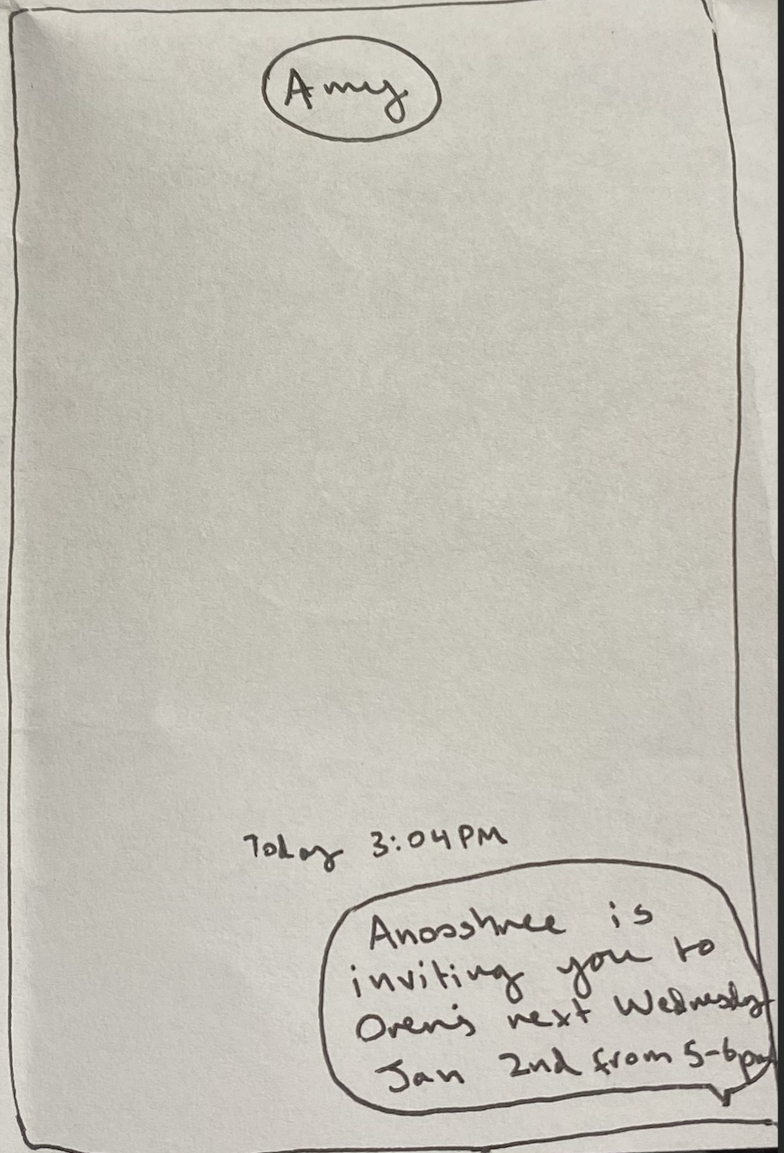
Major Design Change 3 - Confirmation Page
Before - went straight from picking activity to text invite, invite brought user to their iMessage

Slide 20
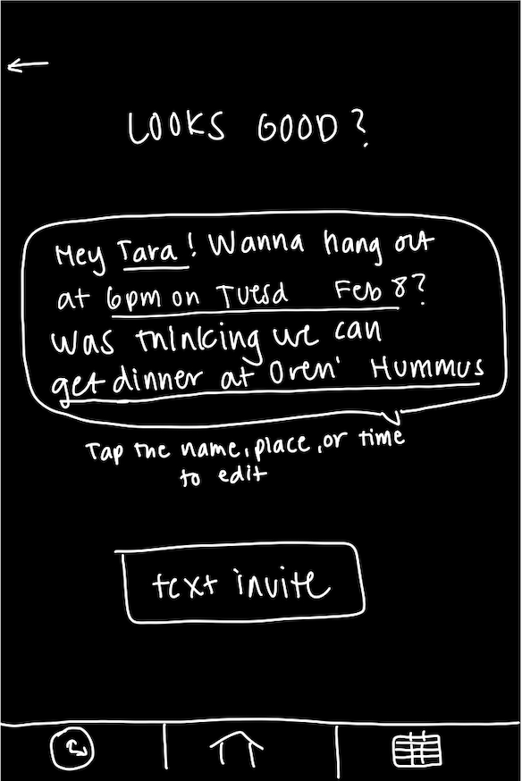
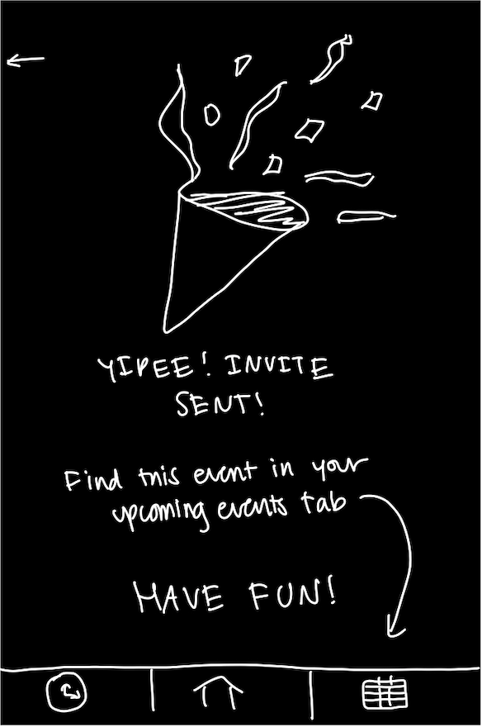
Major Design Change 3 - Confirmation Page
After - preview invite & invite confirmation screen

Slide 21
Major Design Change 3 - Confirmation Page
Changes
Allow user a chance to preview/edit invitation before sending it to a friend
Added in-app invite confirmation screen instead of bringing user to their iMessage
Rationale
Feedback that confirmation screen could have more event details, achieved by having invite preview with these details and telling user to find this event (and event details) in the upcoming events tab
All users were unable to return to app after directed to iMessage, fixed by having an in-app confirmation screen instead of routing to iMessage

Slide 22
Medium-Fi Prototype Task Flows
(see slide notes)
Notes:
From our feedback last week, we chose to rework our three tasks. They were originally set intention, do intention and rate intention. We changed them to be “plan intentional time alone”, “plan intentional time time with a friend”, and “review and reflect.” We made this decision given the fact that set intention was originally just selecting an option between “socialize, self care, and not sure” instead of being a flow of screens and actions. Furthermore, we received feedback that our “do intention” framing felt awkward. Finally, we wanted to make sure our division between simple/moderate/complex tasks accurately reflected the flow of complexity we foresee for our app.
Our reworked simple task is “plan intentional time alone.” This task involves a user scheduling and selecting a self-care activity for themselves. This is the core and simplest functionality of our app: selecting a free time slot and recommended activity. It only involves the user’s schedule and their choices.
Our reworked moderate task is “plan intentional time with a friend.” This task involves a user scheduling an activity to do with a friend which requires selecting a time slot, a friend, an activity, and then sending an invitation message to the friend. This is a moderate task as it builds on the simple task but adds the complexity of selecting a friend, coordinating with a friend’s schedule, and sending a notification. This is also part of the core functionality we’d hope all users to utilize.
Finally our reworked our complex task is “review and reflect on how you’ve spent your time”. This task involves users going through the process of rating a past activity and viewing their weekly report on past activities. This is a complex task as it requires the user to recognize that there is an unrated activity that they need to rate and then rate that activity. It also involves the user viewing a weekly recap of how their activities so far have made them feel. This connects to our larger goal of promoting intentionality after work: we want users to spend their time meaningfully, and that involves reflecting on how different ways of spending their time made them feel, and how they spent their time overall.

Slide 23
Task Flow 1
Plan intentional time alone

Slide 24
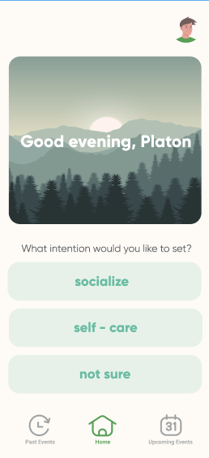
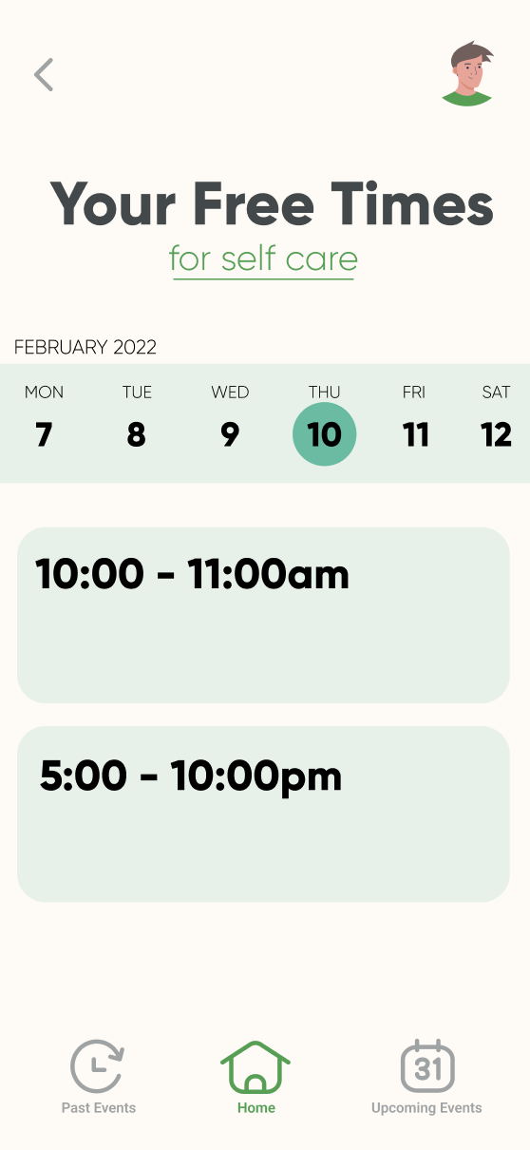
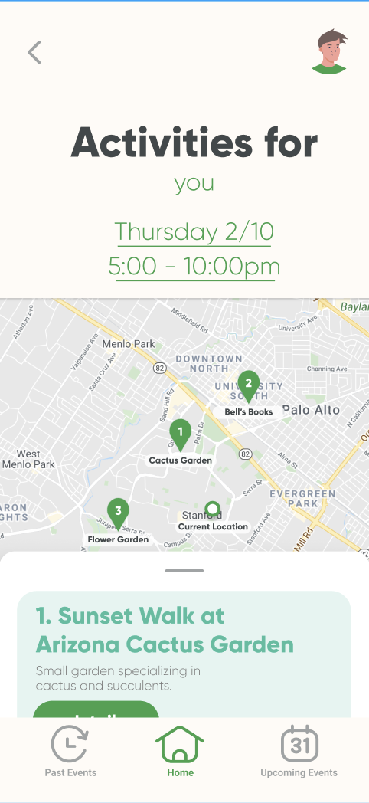
Task Flow 1: Plan Intentional Time Alone
Drag up
Select self-care
Select free time from calendar
Browse curated activities by location and description

Slide 25
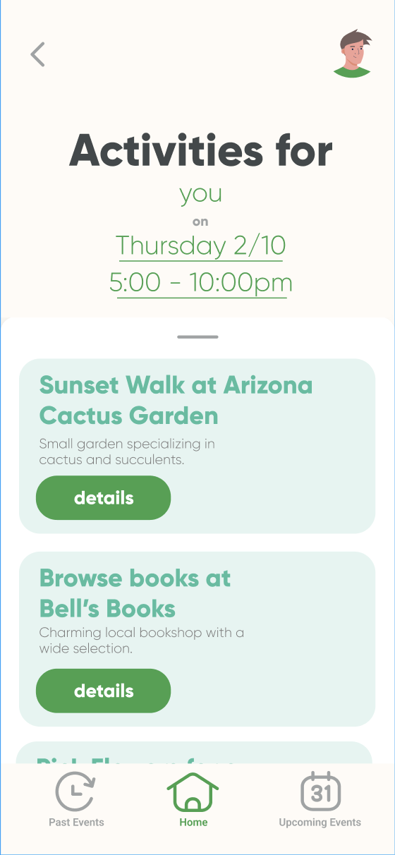
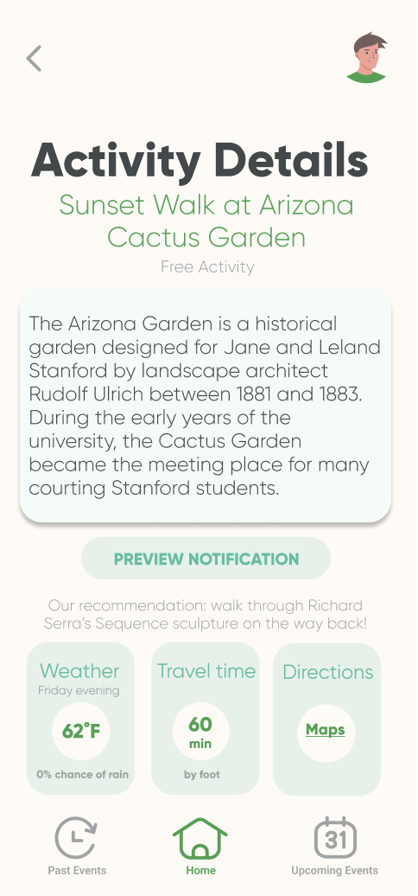
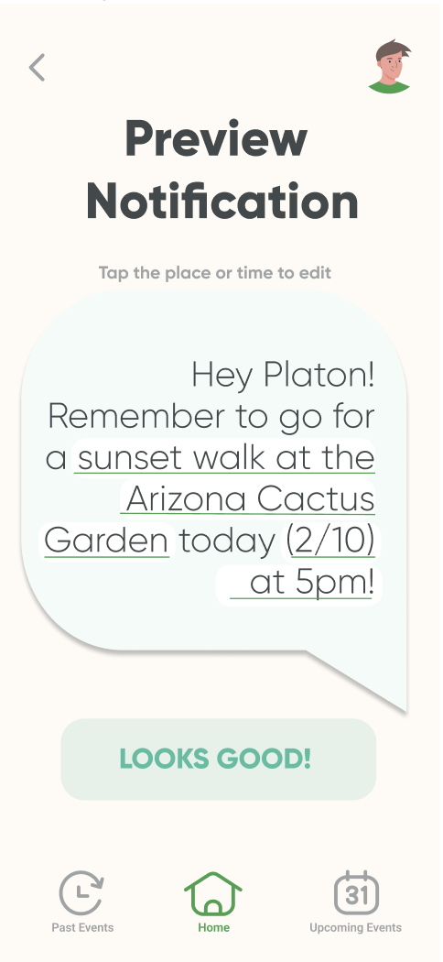
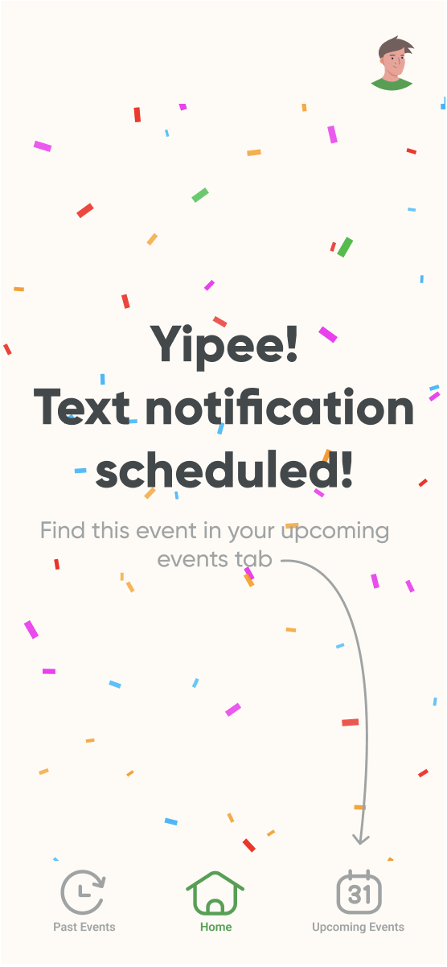
Task Flow 1: Plan Intentional Time Alone
Each underlined field links back to the page where it was selected
Drag up to view more activities
View event details with weather, travel time and link to Google Maps
Preview text notification and confirm/edit
Find details of event in upcoming events tab

Slide 26
Task Flow 2
Plan intentional time with a friend

Slide 27
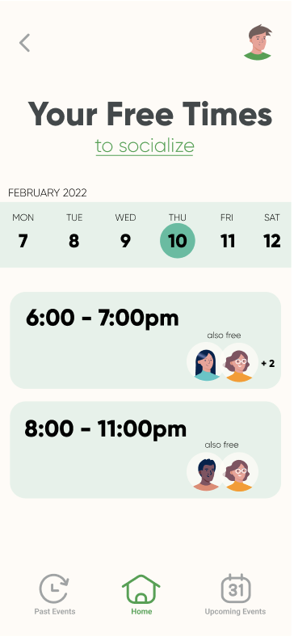
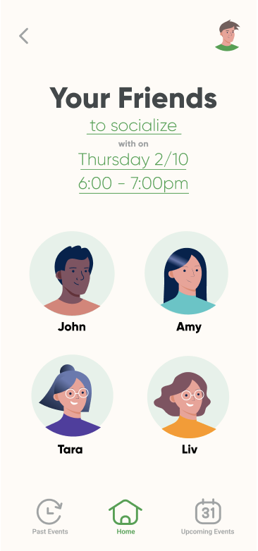
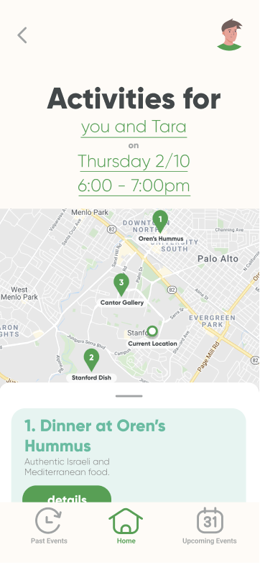
Task Flow 2: Plan intentional time with a friend
Drag up
See times you and your friends are free
Select a friend to hang out with
Browse curated activities by location and description
Select socialize

Slide 28
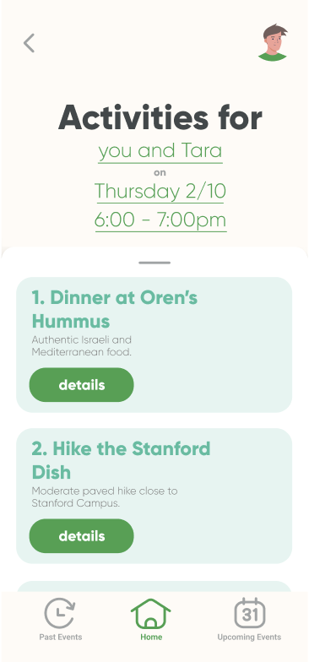
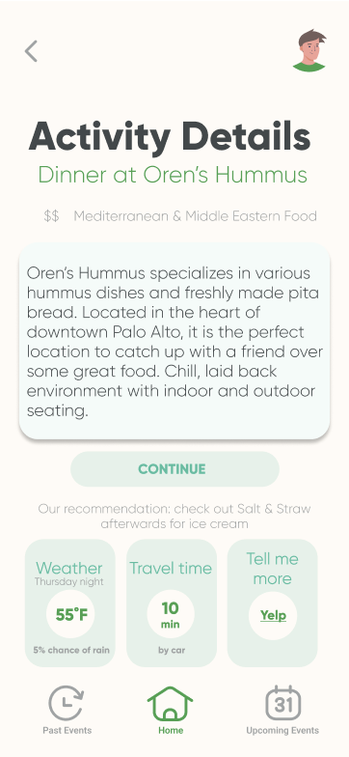
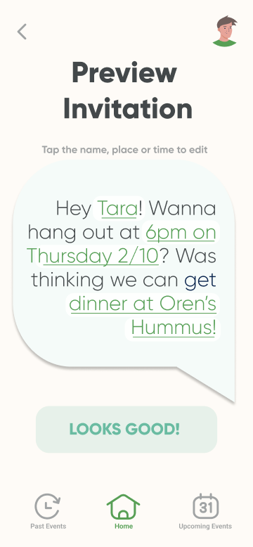

Task Flow 2: Plan intentional time with a friend
Each underlined field links back to the page where it was selected
Drag up to view more activities
View event details with weather, travel time and link to Yelp
Preview text invite and confirm/edit
Find details of event in upcoming events tab

Slide 29
Task Flow 3
Review and Reflect

Slide 30
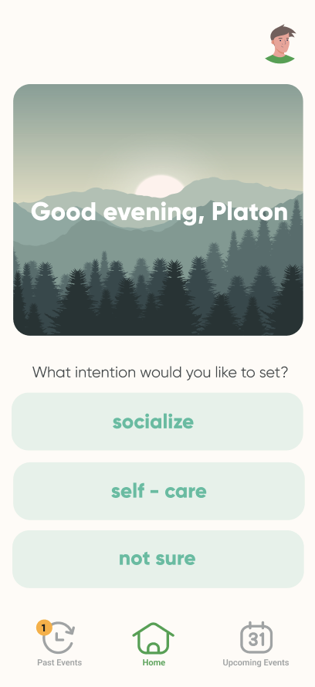
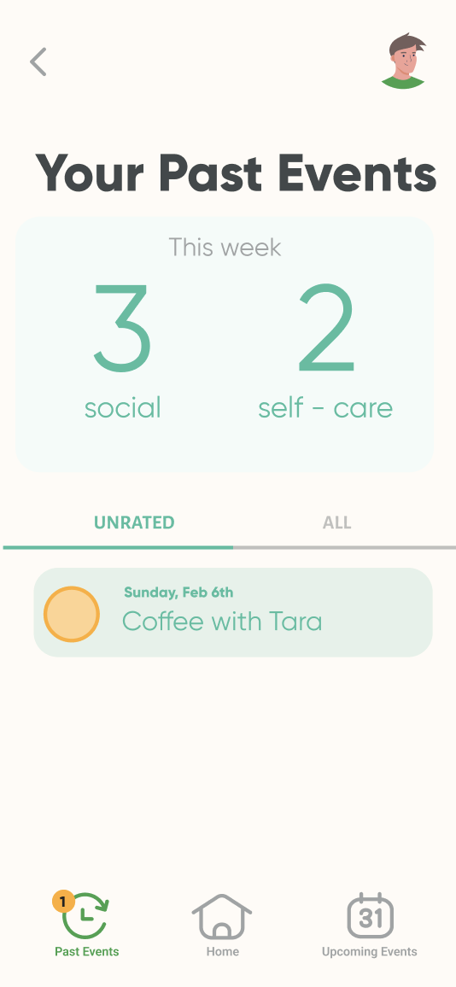
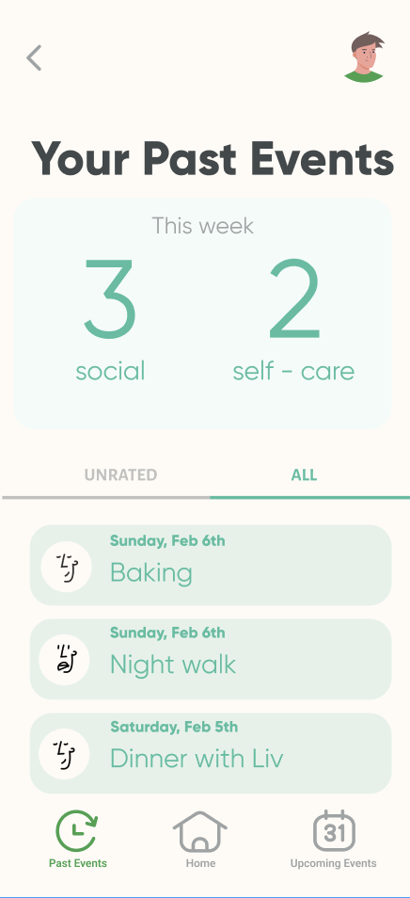
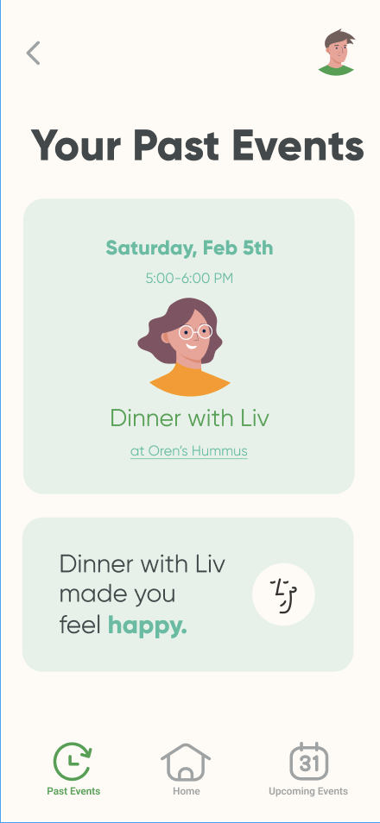
Task Flow 3: Review and Reflect
Notification on past events tab
Toggle between unrated/rated past activities
View details of past activity and see rating

Slide 31
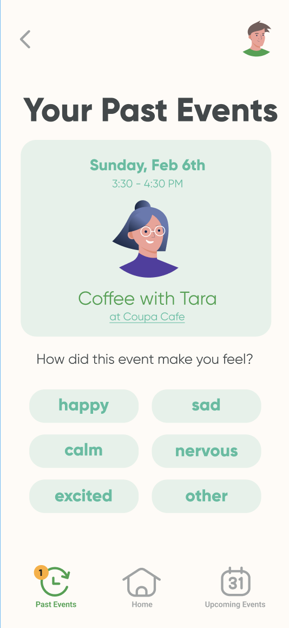
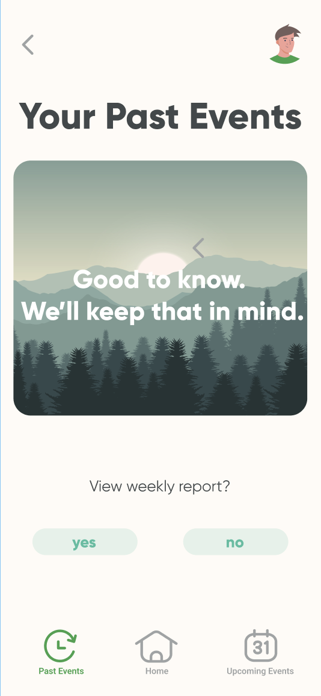
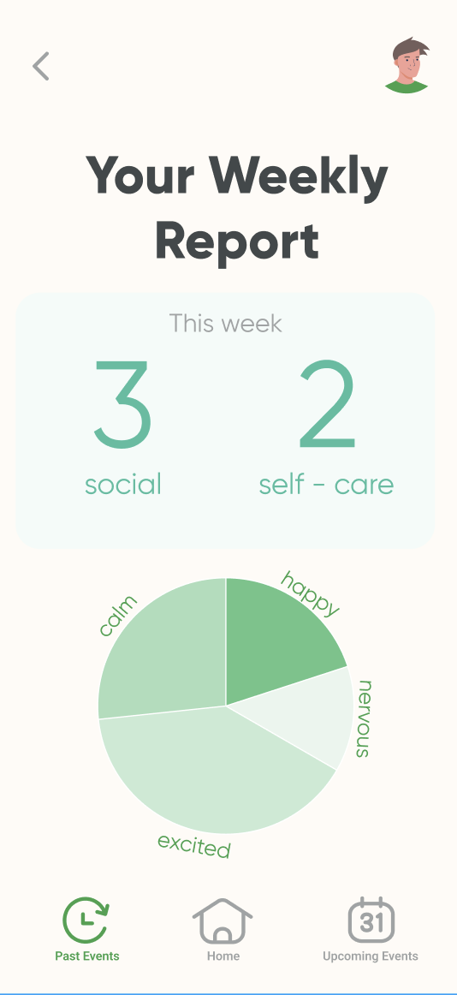
Task Flow 3: Review and Reflect
Rate activity with emotion scale
Rating confirmation and report of how activities (so far) have made user feel

Slide 32
Prototype Overview

Slide 33
Design and Prototyping Tools
Figma for wireframing and prototyping application walkthrough
Freely-available fonts, color schemes, icons, and illustrations for UX mockups and design elements.
PROS:
Easy collaboration
iPhone screen mockups with clickable features
Grouping for screens in the same task flow
Easy to import design elements
CONS:
Individual wiring of each component for each screen
Need to copy screens for variations of one task flow
Have to build out each of the graphics for each screen

Slide 34
Limitations and Tradeoffs
Had to manually generate ideas for each social and self-care activity, then build screens for each of these options
Could not login each user and sync their interests and potential friends on the app
Users cannot rate activities they have scheduled; instead they rate a hard-coded activity and view an example weekly report
Could not add detail screens for all activities (past, upcoming, and currently scheduling)

Slide 35
Wizard of Oz Techniques
Users navigate to a hard-coded screen that shows them what it would look like to send an invitation to a friend or schedule an event for themselves
Users enter as “Platon,” an already established user with designated friends and interests
Users are given a specific calendar time to schedule events for both self-care and socializing

Slide 36
Hard-Coded Features
Friends: the medium-fi prototype does not access a user’s contacts
Interests: we entered examples because building out profile setup would require registering user’s free-form responses
Available times: we don’t have access to the user’s calendar and gave two example time slots
Maps and Yelp for each activity: we took screenshots of what accessing another app from 5-9 would look like
Past events: we provided examples of what a past week would look like
Weekly report: we don’t have enough information to build this out, so we used out available reactions to create an example report
Upcoming events: we provided examples in addition to the events the user schedules
Recommended activities: we generated a few suggestions, assuming that the user is located in/around Stanford

Slide 37
END

